Slide 1


Cryptographic Adversaries From game theory to cryptography, and vice versa
WANG Zhongming (王中明)
Please feel free to ask question at any time.

Slide 2
Conventional Participants in Crypto.
Semi-honest/passive adversaries ☺
who faithfully follow the protocol.
Malicious/active adversaries ☹
who behave in arbitrary fashion.
Does semi-honest adv. match the real-world adv.?
Should semi-honest and malicious be our first choice?

Slide 3
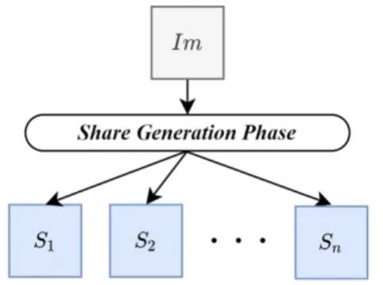
Secret Sharing under Conv. Players
1. An honest dealer generate n shares from a secret I.
2. The dealer distributes the shares to n players.
Each player obtains a share si.
3. The players faithfully broadcast their share si.
All the player can reconstruct the share I! ☺
Assumptions: 1) all the players are semi-honest, and 2) the broadcast are happen synchronously.

Slide 4
What if? Selfish Player(s)
What if? One of the players is selfish.
1. The dealer distributes the shares to n players.
2. The players except the selfish one faithfully broadcast share si.
3. Only the selfish player can reconstruct the secret I! ☹
What if? More selfish adversaries.
They lose nothing! What’s worse?
The adversaries will not be punished for their misbehavior!

Slide 5
Selfish Player -> Rational Adversary
Rational adversary
1) Prefers that it learns the output while others do not,
2) has no incentive to deviate from the protocol.
Rational adversaries in secret sharing
1) Broadcast his share -> Obtain the secret.
2) Not broadcast -> Obtain the secret, or lose nothing!
Obviously, a rational adv. prefers the second strategy.

Slide 6
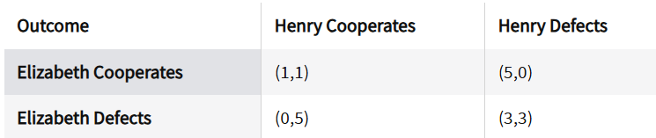
The Game Theory: Prisoner’s Dilemma
Two rational suspect, two possible strategies.
Each suspect always has an incentive to defect!
Nash equilibrium: No player can benefit by unilaterally changing their strategy.
Defect is the strict dominated strategy.

Slide 7
Rational Secret Sharing
The goal: build a Nash (or other) equilibrium for the protocol.
In other words, the rational players’ dominated strategy is to let all the players reconstruct the secret.
The impossibilities:
Any SS protocol terminating in a fixed number of rounds cannot be secure under rational adv.. Why?
Does not exist rational 2-out-of-2 secret sharing protocol.
The solution:
Prob. protocols without a fixed upper bound on round complexity.
[HT04,STOC] Rational Secret Sharing and MPC

Slide 8
Rational SS: [HT04] for 3-out-of-3
1. An honest generates a valid shares for each player.
2. Each player flips a coin ci that equals to 1 with prob. a.
3. The players run a MPC protocol that computes c* = \xor ci.
4. For each player: If c* = ci, broadcast his share; otherwise, do nothing.
5. Result depends on the number of shares that are broadcasted.
If 3 shares, the secret is successfully reconstructed and all players obtain the secret.
If 0/2 shares, this protocol will be terminated and no one obtain secret.
If 1 share, this protocol will jump to Step 1 and no one obtain secret.
[HT04,STOC] Rational Secret Sharing and MPC

Slide 9
[HT04]: Analysis
Consider a rational player 3:
He would not set c3 to 0/1 before c* since he cannot observe c1 or c2.
If c* = 1, how the player 3 behaves?
c3 = 0, c1=c2=0: Change c3 to 1 would jump to next iteration.
c3 = 1, c1=c2=1: Change c3 to 0 would terminate the protocol.
If the prob. a is properly chosen, a Nash equilibrium is built!
Expected round complexity: O(a^{-3})
How about 2-out-of-2 rational secret sharing?
But, how?
[HT04,STOC] Rational Secret Sharing and MPC

Slide 10
Rational SS: [GK08] for 2-out-of-2
1. For each player, an honest dealer generates a true shares with prob. b; otherwise, it generates a fake share.
The true and fake shares are indistinguishable to the players.
2. The players broadcast their received shares.
3a. If all players broadcast the share,
The secret is reconstructed with prob. b^{n};
otherwise, jump to step 1.
3b. If one share is missing, terminate the protocol.
We now break the impossibility in [HT04]! But, why?
[GK08,SCN] Rational Secret Sharing, Revisited

Slide 11
[GK08]: Analysis
The insight: The dealer may generate fake shares (i.e., add randomness to the protocol).
The benefits:
Break the impossibility for 2-out-of-2 rational secret sharing.
Simpler operations and assumption (no private channel).
Unsolved limitation:
The honest dealer must be get involved in each iteration.
[GK08,SCN] Rational Secret Sharing, Revisited

Slide 12
[GK08]: Removing the Dealer
Setup: The dealer generate a share and certificate (si,di) for each player.
1. The players run a MPC protocol against one malicious player.
- Each player input the value (si,di). The MPC verifies the signature. And, abort if the verification fails.
- The MPC reconstruct the true secret s.
- With prob. b, the MPC generates new shares s’i for each player from the secret s.
- Otherwise, the MPC generates new shares s’i for each player from a fake secret s.
2. If cheating is detected in MPC, terminate the protocol.
[GK08,SCN] Rational Secret Sharing, Revisited

Slide 13
[GK08]: Removing the Dealer
3. The players broadcast their received share s’i
- All players broadcast, a secret s is reconstructed. If s \in S, terminate the protocol; otherwise, jump to step 1.
- Some players don’t broadcast, terminate the protocol.
The insight: Replace the dealer to a MPC protocol that run by the players themselves.
[GK08,SCN] Rational Secret Sharing, Revisited

Slide 14
From Game Theory to Crypto.
Cryptographic adversaries (with pre-defined strategies):
Semi-honest or Malicious players.
Guarantees are provided in the face of worst-case adversarial behavior
Game-theoretic adversary (with undefined strategies):
Rational players.
Concerns itself only with rational deviations.
Let’s bring game theory to cryptography: Rational cryptography!
How about a mix of rational and malicious players?
[LT06,CRYPTO] Rationality and Adversarial Behavior in MPC

Slide 15
Rational MPC vs. Fair MPC
Rational MPC:
The players have many strategies, but they prefer the strategy that follows the protocol.
In other words, following the protocol is the dominated strategy, which forms a equilibrium.
Fair MPC
The players have many strategies, and they can chose any one.
However, for any strategy, the players always obtain the same output.
In other words, selfish adversaries cannot profit from their misbehavior.
We can get fair MPC from rational MPC!

Slide 16
Prisoner’s Dilemma: Solution
Two rational suspect, two possible strategies.
Each suspect always has a incentive to defect!
A mediator (for mediated game with multiple equilibrium).
Penalty after defects
Multi-round game
Can cryptography helps the game theory?

Slide 17
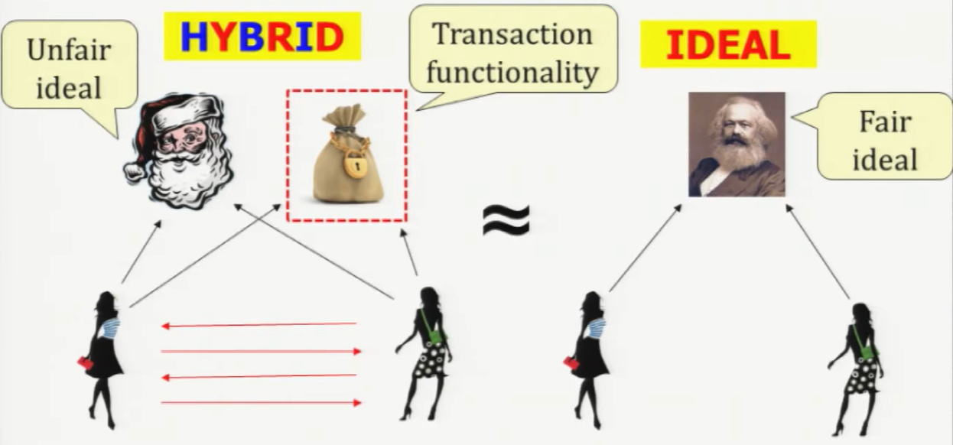
From Game Theory to Fair MPC
We can borrow the idea of mediator or penalty.
[Lindell08,CT-RSA] Legally Enforceable Fairness in Secure Two-Party
[BK14,CRYPTO] How to Use Bitcoin to Design Fair Protocol

Slide 18
From Crypto. to Game Theory
Using cryptographic protocol to replace a trusted mediator,
which is run by the players themselves.
[GK08,SCN] How the authors remove the dealer is an example!
[Katz08,TCC] Bridging Game Theory and Cryptography
[DSR06,CRYPTO] A cryptographic solution to a game theoretic
problem

Slide 19

Idea in Parallel: Covert Adversaries
There are some players can behave in malicious.
However, they do not want their misbehavior be detected by honest players.
For example, NSA does not want PRISM to be discovered.
[AL07,TCC] Security Against Covert Adversaries
Calc. the detection prob. of misbehavior.

Slide 20
Conclusion
From the game theory to cryptography:
Borrow the model of players.
Borrow the solution of implementing equilibrium.
From cryptography to the game theory
Using cryptographic protocols to replace a trusted mediator.
Conv. Crypto.
Semi-honest
Covert
Malicious
Rational
Mixed behavior
Fair MPC
Rational Crypto.

Slide 21
Materials of This Talk
Rational Protocol
[HT04,STOC] Rational Secret Sharing and MPC
[GK06,SCN] Rational Secret Sharing, Revisited
[Katz08,TCC] Bridging Game Theory and Cryptography: Recent Results and Future Directions
Fair Protocol
[Lin08,CT-RSA] Legally-Enforceable Fairness in Secure 2PC
[BK14,CRYPTO] How to Use Bitcoin to Design Fair Protocols

